Slide 1

APPRENTICESHIP TRAINING IN FINLAND IS UNIQUE AND FLEXIBLE

Slide 2
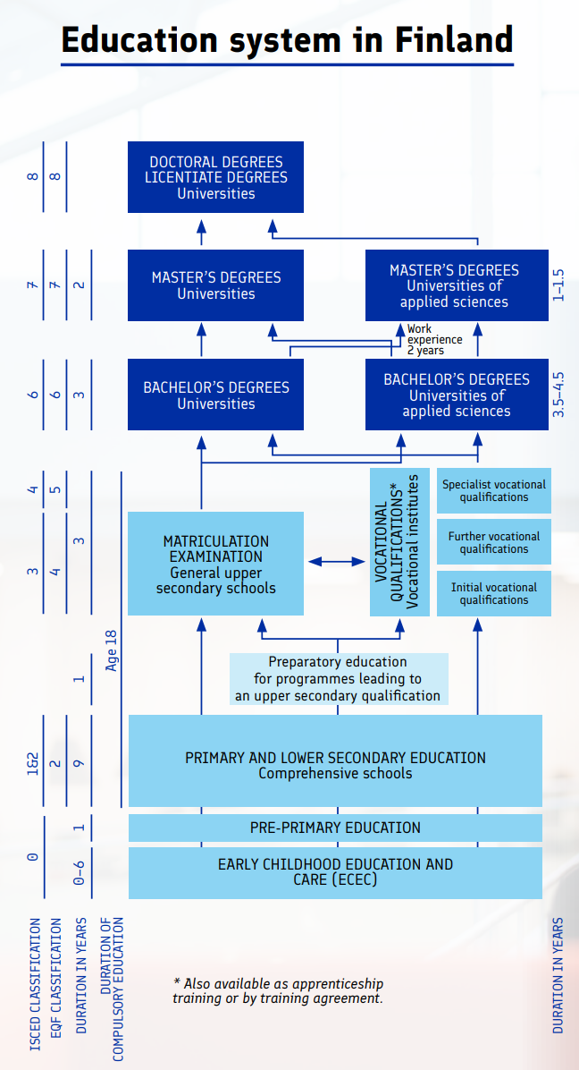

Slide 3
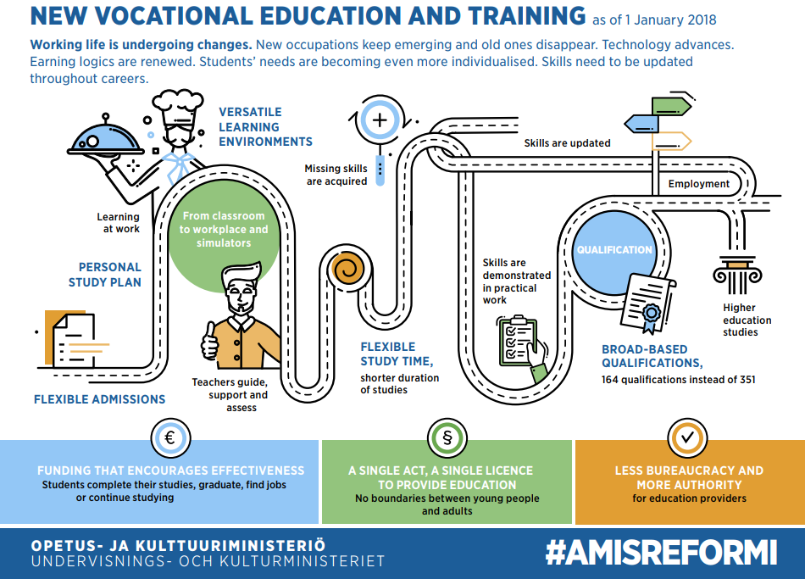


Slide 4
THE CHANGES AFTER THE REFORM IN 2018
Enhanced Employer Collaboration: Employers have a more significant role in planning and implementing students’ study paths.
Quality Assurance: The reform introduced stricter quality control standards for apprenticeship training to ensure the quality of education and protect students' rights.
Competence-Based Approach: The reform emphasized competence-based education and training, where education and qualifications are based on the individual's acquired competence. This provides students and employers with more flexibility and enables personalized study paths.
Varied Length of Apprenticeships: The extent of apprenticeship training can vary significantly. It is up to students’ and employers’ needs as well as students’ prior experience, if there is such.
All these changes aimed to make apprenticeship training more flexible, learner-centered, and effective, better aligned with the needs of the labor market. They also encourage lifelong learning and provide students with improved opportunities to develop their skills and find employment in various fields.

Slide 5
THE REQUIREMENTS OF APPRENTICESHIPS
Apprenticeship is a temporary employment contract.
All those who are at least 15 years old can study through an apprenticeship.
Skills are mainly or entirely acquired at the workplace, but often studies at school or/and online are included as well.
Work is done for at least 25 hours per week according to the qualification requirements.
The student receives salary according to the collective agreement used in industry.
At the workplace, the student is guided and taught by an experienced workplace instructor.
Skills are proven with competence demonstrations at the workplace.

Slide 6
APPRENTICESHIP TRAINING FOR THE STUDENTS
Through an apprenticeship, student will complete second degree vocational qualifications, which give the same eligibility for further studies as a vocational college and an upper secondary school and the same qualifications as a vocational college.
There are more than 160 qualification options → Vocational upper secondary qualification, further vocational qualification, and specialist vocational qualification.
Apprenticeship contract: entire degree, part degree, season
Salary and benefits

Slide 7
APPRENTICESHIP IS AN EFFECTIVE WAY TO RECRUIT OR TRAIN CURRENT STAFF
Cost-effective and flexible
Employers’ needs can also be taken into account when planning students’ PCDP
  Not always the whole qualification → precise knowledge.
Good way to commit students by offering apprenticeships during summer jobs or possibility for eg second year students to complete studies through apprenticeship at workplace → Especially companies, who suffer lack of employees, use this a lot.
Compensation to the employer for training the apprenticeship student / Higher compensation, if the student is younger than 20 years old.
Possibility to get monetary support for employing unemployed through apprenticeship.

Slide 8
ENTREPRENEUR’S APPRENTICESHIP
An entrepreneur’s apprenticeship offers flexible opportunities for an entrepreneur to study, whether you have just started or have already gained more experience → growing company, updating professional skills etc.
An entrepreneur studying apprenticeship training is guided by a workplace tutor, mentor. → Mentor Bank
The entrepreneur demonstrates competence in the company.
Costs for entrepreneurs

Slide 9
OMAN OPPILAITOKSEN TILASTOTIETOA: LISÄÄ TÄHÄN DIAAN
Ajatus: tässä voisi olla esimerkiksi karttakuva → Suomi ja oma oppilaitos sijaintina, joka sisältää tietoa tutkinnoista, opiskelija- ja oppisopimusmääristä ja vaikkapa opiskelijatyytyväisyydestä esim. 4,5

Slide 10
THANK YOU!

