Slide 1


the meeting of the European Alliance for Apprenticeships
15 October 2019
The European Vocational Skills Week in Helsinki ms Virpi Spangar chairman of apprenticeship experts in finland association

Slide 2
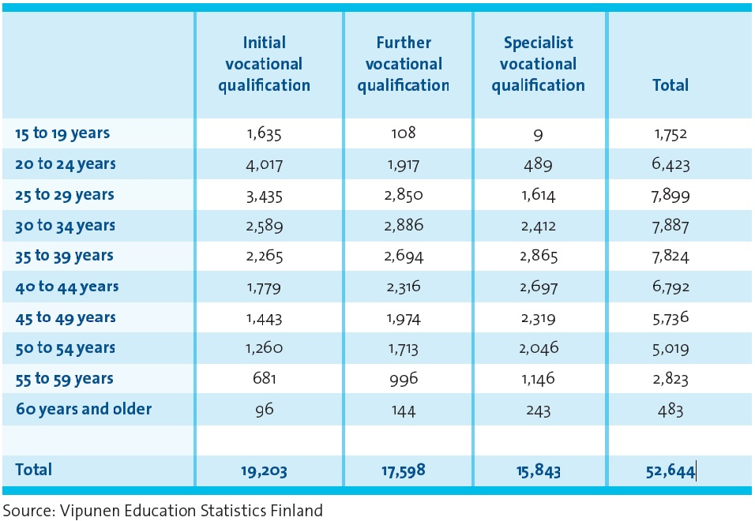
Students in apprenticeship training by age group and qualification type in 2017
3,638 students were entrepreneur apprentices. Of these, 752 agreements were made for initial vocational qualifications and 2,886 for further or specialist vocational qualifications.

Slide 3
Highlights OF Finnish experiences related to apprenticeships for adults
Work-based learning is integrated into vocational education and training system
Personal competence development plan is drawn up for each VET student
VET system is flexible and offers a wide range of opportunities
Real work tasks offer a good opportunity for continuous learning
Apprenticeship is built on trust and shared responsibility
https://www.oph.fi/sites/default/files/documents/finnish_vet_in_a_nutshell.pdf

Slide 4
Summary
Working life is undergoing changes.
Skills need to be updated throughout careers.
In Finland apprenticeship training promotes equality of opportunity for adults and young people.

